Slide 1
Olympic host cities
Which city will be the host in 2032?

Slide 2
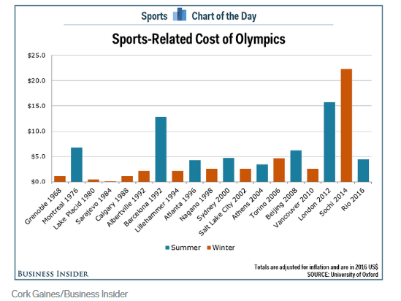
Many cities have hosted the games but not all of them were successful in making money. Let’s find out if a city should undertake it.

Slide 3
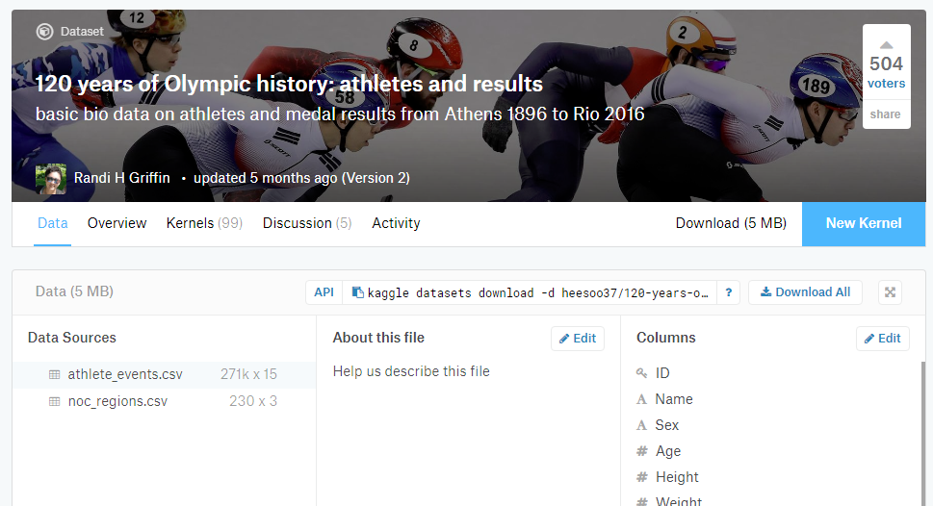
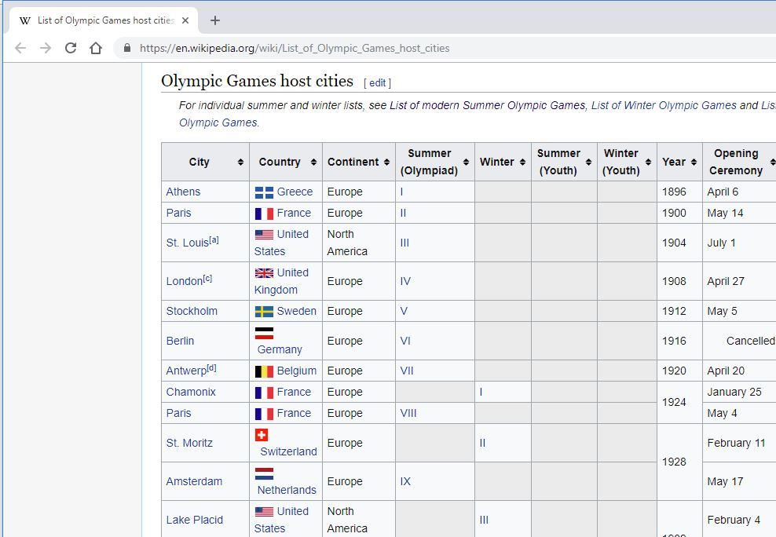
Past host cities
Past host cities were extracted from public data set.

Slide 4
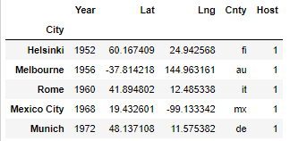
City coordinates
City coordinates from geopy using city names

Slide 5
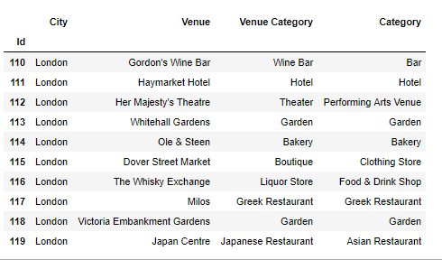
Venues in cities
FourSquare "Explore" API provided popular venues using coordinates

Slide 6
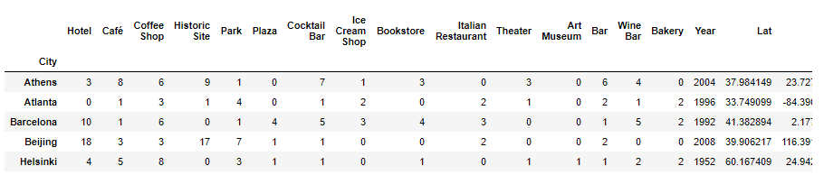
Venue categories
The top 15 popular venue categories in cities

Slide 7
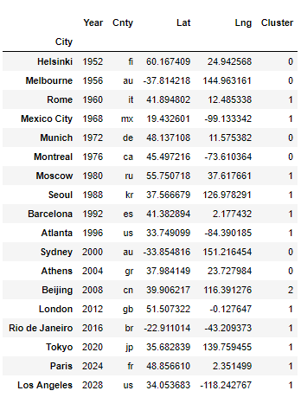
KMeans clustering
KMeans clustering of cities by their mean of venue categories

Slide 8
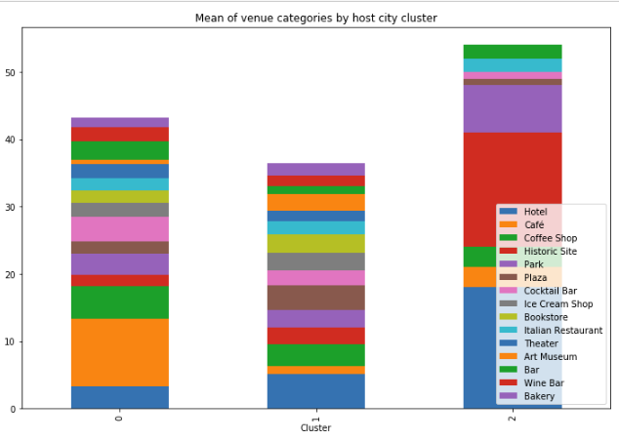
How the clusters compared

Slide 9
Final host city list
To reduce data noise, we focused on host cities in Cluster 1: Rome, Mexico City, Moscow, Seoul, Barcelona, Atlanta, London, Rio de Janeiro, Tokyo, Paris, Los Angeles

Slide 10

Non-host cities
From world’s best cities list, picked the top ones that have not hosted before. Retrieved their coordinates and venues.

Slide 11
Non-host cities
The non-host cities included were: Amsterdam, Boston, Chicago, Dubai, Hong Kong, Madrid, New York, San Francisco, San Jose, Singapore, Toronto, Washington, Zurich

Slide 12
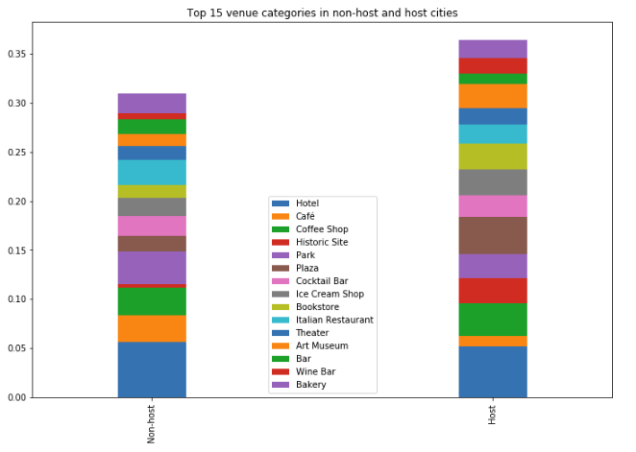
Venues in cities
How the venues compared between non-host and host cities

Slide 13
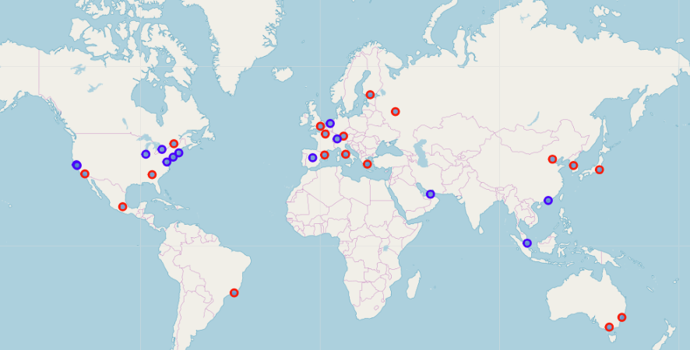
Host and non-host cities
Host cities are in red

Slide 14
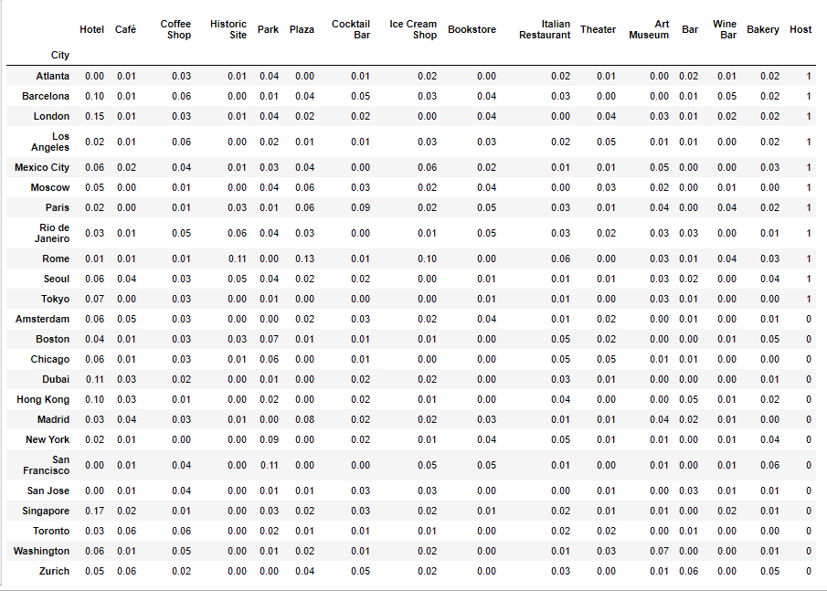
Final data set for model evaluation

Slide 15
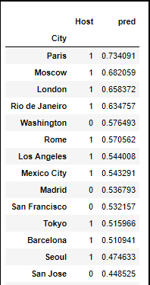
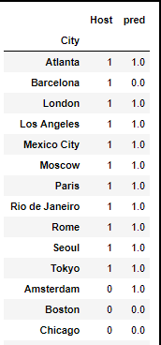
Logistic Regression and Decision Tree predictions
The two models show consistent results on host cities, but different predictions on non-host cities.
Decision Tree predictions
Logistic Regression predictions

Slide 16
Results
Washington, Madrid and San Francisco showed up had prediction over 0.5 in Logistic Regression.
Amsterdam was the only non-host city suggested by Decision Tree. Therefore, the two models showed differing results.
Since 2028 Games will be held in North America, a
European city will most likely be selected next, so it will be Madrid or Amsterdam.

Slide 17
Discussion - 1
Models are sensitive to data points
Inadequate data points and noise in data
The number of venue categories exceeded the number of data points, so high feature/data ratio
FourSquare Explore API returned live data that varies with the time of the day

Slide 18
Discussion - 2
Venue data for now has a lesser correlation with the host city selected decades ago.
Host city selection had other factors not reflected in venues: financial, political, geographical, etc.
FourSquare data loaded on food related venues

Slide 19
This was part of capstone project for Coursera course “Applied Data Science Capstone”
Charles Fung
charles.fung.87@gmail.com
Published: Nov, 2018

